Slide 1
Computer Software
Unit: 3

Slide 2
COMPUTER SOFTWARE
Computer software, or just software, is a collection of computer programs and related data that provides the instructions for telling a computer what to do and how to do it.
A program is a set of instruction arranged in a logical way that a computer can run.
Any set of instructions that guides the hardware and tells it how to accomplish each task.
Hardware is tangible whereas software is intangible, i.e. it cannot be touched.

Slide 3
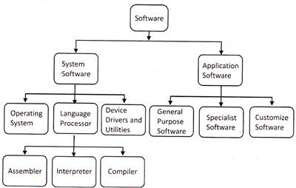
Classification of Software

Slide 4
System Software
System Software is a software which is designed in such a way so that it can control and work with computer hardware. It acts as an interface between the device and the end user.
• Provides platform to other software programs.
• Controls and works with hardware.
• Enables the hardware tools to work together:
  Transferring data between memory and disks.
  Transferring data between memory and CPU.
  Rendering output to output devices.
  Receiving input from input devices. •
Examples:
  Operating system
  System development programs
  Device drivers

Slide 5
Features of System Software
An important feature of System Software are:
System Software is closer to the system
Generally written in a low-level language
The system software is difficult to design and understand
Fast in speed
Less interactive
Smaller in size
Hard to manipulate

Slide 6
Application Software:
An application program (application or app for short) is a computer program designed to carry out a specific task other than one relating to the operation of the computer itself, typically to be used by end-users. Word processors, media players, and accounting software are some examples of application software.
Application software has a variety of uses. Such as:
  To make business activities more efficient.
  To assist with graphics and multimedia projects.
  To support home, personal and educational tasks.
  To facilitate communications.

Slide 7
Features of Application Software
An important feature of Application Software:
Perform more specialized tasks like word processing, spreadsheets, email, photo editing, etc.
It needs more storage space as it is bigger in size
Easy to design and more interactive for the user
Generally written in a high-level language

Slide 8
Application software can further be subdivided into 3 categories:
1) General Purpose software:
General-purpose application software is software used to perform a broad variety of tasks and is useful to nearly all computer users, such as word processing, graphics editing and spreadsheet applications.
2) Specialist software
Applications designed to be used for specific tasks such as company payroll, stock control systems, appointment systems, e-commerce sites, etc. Some examples are Library Ex+ for library management, Tally for financial accounting, etc.
3) Customized software
This type of software is tailor-made software according to the user's requirement. This type of software is developed to meet all the requirements specified by the user. For instance, a company wants to computerize its 'Accounts Department' and gets software developed according to the user's needs. This is also known as tailor made or bespoke(made for a particular customer or user ) software.

Slide 9
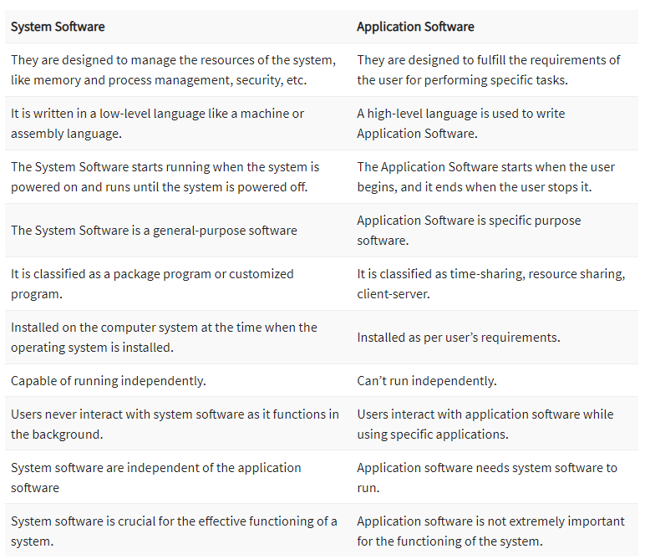

Slide 10
Functions(Features) OF OS:
Process management: Process management helps OS to create and delete processes. It also provides mechanisms for synchronization and communication among processes.
Memory management: Memory management module performs the task of allocation and de-allocation of memory space to programs in need of this resources.
File management: It manages all the file-related activities such as organization storage, retrieval, naming, sharing, and protection of files.
Device Management: Device management keeps tracks of all devices. This module also responsible for this task is known as the I/O controller. It also performs the task of allocation and de-allocation of the devices.
I/O System Management: One of the main objects of any OS is to hide the peculiarities of that hardware devices from the user.

Slide 11
Secondary-Storage Management: Systems have several levels of storage which includes primary storage, secondary storage, and cache storage. Instructions and data must be stored in primary storage or cache so that a running program can reference it.
Security: Security module protects the data and information of a computer system against malware threat and authorized access.
8. Networking: A distributed system is a group of processors which do not share memory, hardware devices, or a clock. The processors communicate with one another through the network.
9. Job accounting: Keeping track of time & resource used by various job and users.
10. Communication management: Coordination and assignment of compilers, interpreters, and another software resource of the various users of the computer systems.

